Slide 1
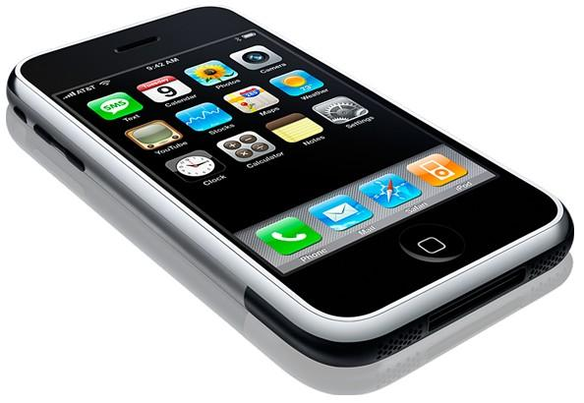
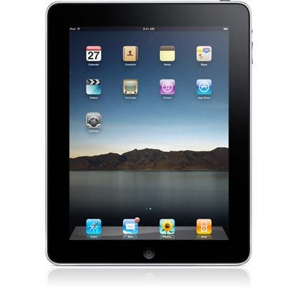
Apps to Improve
Reading Comprehension
in the Classroom
#appsthatwork

Slide 2
Table of Contents
SIG Group Members - Slide 3
Outline and Pedagogical Reasoning - Slide 4
General Purpose - Slide 5
Show Me - Slide 6-7
Evernote - Slides 8-9
Brain Pop - Slide 10
Flashcardlet - Slides 11-12
Confer - Slides 13-15
SimpleMind-Slides 16-17
Diigo 18-19
Oceanhouse Media Book Collection- Slide 20
Twitter Hashtag - Slide 21
Resources - Slide 22

Slide 3
SIG Group Members
Marc Schulz - Show Me
Molly Turner - Evernote
Julie Klein- SimpleMind
Samuel Lopez-Romero - BrainPOP
Robert Fickbohm - Oceanhouse
Chris Daugherty- Diigo
Lindsay Silver - Confer
Ariel Myers - Flashcardlet

Slide 4

Outline and Pedagogical Reasoning
Technology Chosen: Any Smartphone, Apple Device, or PC with internet access
Pedagogical Reasoning: Although teachers present lesson materials in various engaging ways, learning will not occur unless students truly understand the information being delivered. The ability to comprehend subject specific text is essential to this understanding. Through the use of various apps, students will be able to function as active participants in their learning. Information can also be shared electronically from teacher to student and among students.

Slide 5
How's it All Connected?
Focus: To introduce web applications that increase reading comprehension of content related materials. These applications can be adapted for use by teachers and students at the elementary and secondary level across all subject areas.
Teacher: To incorporate web based applications into the daily curriculum that boosts comprehension of subject specific information .
Student: To increase engagement and comprehension through the utilization of novel technologies with the goal of boosting comprehension. These technologies will likely encourage interaction with the material outside of class time.
Subject Matter: Apps can be applied to any subject matter or grade level with the general goal of increasing comprehension of subject specific material.
Context: The students will be be using the applications to increase their comprehension of the subject matter.

Slide 6
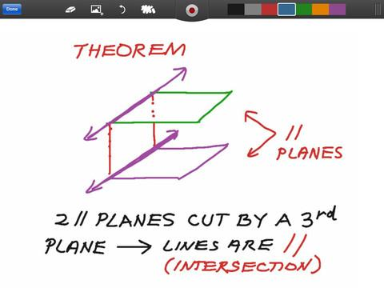
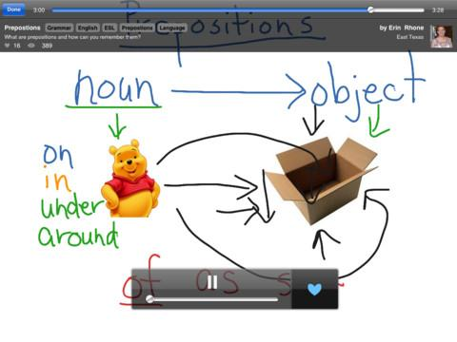
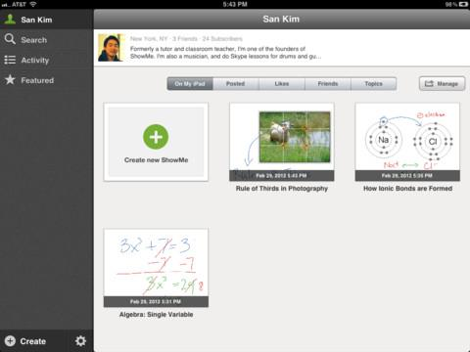
ShowMe
A digital whiteboard app designed for the IPad.
Teachers Can Use It:
1. Create a "focus" and use it as a Flip Lesson.
2. To post a lesson on the web (view 24/7).
3. WIth the recording device (screen & audio) can show sequence or order
Students Can use It:
1. To review lessons at anytime.
2. Practice & record problems & procedures.
3.Record and show teachers thought process.and comprehension.
4. Create and submit final products.
5. Record audio to demonstrate deeper understanding.
6. Struggling writers may use it to record verbal answers.

Slide 7
ShowMe
Reading Comprehension
Before/After reading a passage, a student;
  can record predictions/results
  create a colorful KWL
  or, draw/upload a picture
  can demonstrate sequence of events by using the recording device.
ShowMe also provides audio recording to accompany the drawing.
The final product can be submitted/shared via the Internet with the Teacher.
Watch this example of a student demonstrating their knowledge of Mitosis
For more ideas visit:
TechThoughtsToday
Tips2012

Slide 8

Evernote
A digital note-taking app for creating and sharing information between teachers and students
Teachers Can Use
It To...
Develop note sets that incorporate text, audio, and visual components
Share information that can be accessed using Apple devices, PC's, and mobile phones
Create portable textbooks
Students Can Use
It To...
Review concepts from class through multiple modes any time of day
Share and edit information among peers
Take notes in class
Organize research

Slide 9

How can Evernote boost reading comprehension?
Evernote gives teachers the ability to hyperlink definitions of important terms to the text
  Students can interact with the text by clicking on the terms they do not understand
Important concepts can be reinforced in multiple formats (ex. video, text, diagrams and charts).
  The exposure to other types of media helps students make more sense of the text they are reading
Allows students to interact with the text.
  Students are not generally allowed to write in their textbooks. With Evernote they can make notes in the text and "clip" information into their working notes
Want to know why students love Evernote?

Slide 10


BrainPOP
BrainPOP Featured Movie for iPod/iTouch/iPad: Provides hundreds of animated videos about Science, Math, Social Studies, etc. There are also quizzes after every video to test knowledge about the subject. This application can help improve reading comprehension by having students visualize and hear words that are part of content vocabulary.
Teachers Can Use It As a...
visual aid to increase comprehension of subject
tool to measure student's comprehension
helping tool to visualize and hear words that are part of content vocabulary.
Students Can Use It ...
To review concepts by watching interactive videos
To take quizzes to measure comprehension
Videos as a preview before reading text or support material to help improve reading comprehension.

Slide 11

Flashcardlet
A digital flashcard application that allows educators and students to create, share, organize and use this study tool on any Apple Device.
Teachers Can Use It To...
Create a deck of flashcards to help students memorize any type of educational materials.
Create flashcards using text, audio clips or visuals.
Share their deck via Quizlet(www.quizlet.com) or email for every student to have access.
Students Can Use It To...
Review content learned in class.
Prepare for exams and quizzes or simply for additional practice.
Customize their own study experience by using different features offered.

Slide 12
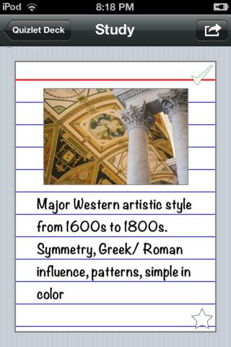
Subject Matter:
Flashcardlet is a helpful study tool that can be used for any subject and all grades levels.
Context:
Flashcardlet helps aid all students of all ages comprehend material faster and more efficiently.

Slide 13
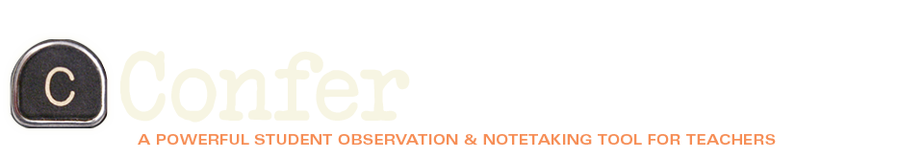
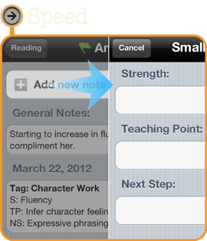
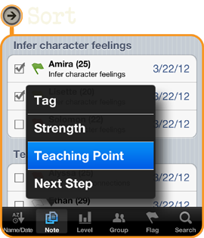
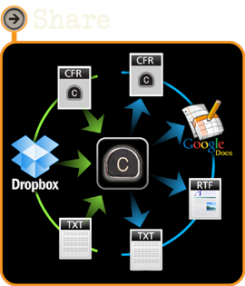
Teachers:
-Track student data -Create small groups for instruction
- Share instructional strategies with -Upload data to a Google
colleagues Spreadsheet
-Sort children by teaching point, -Search through data by student
next step or strength
-Group children by ability and
level

Slide 14
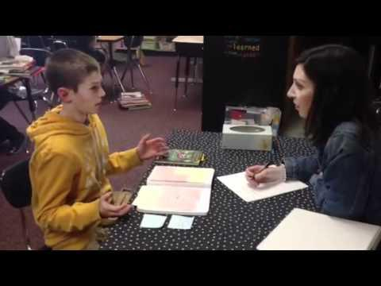
Why is conferring important and What does it look like?
This is a 6th grade example working on main ideas and supporting details.

Slide 15
Why is Conferring Important and How does Confer App fit in?
Teachers are able to see and hear what their students are thinking about as they read the book and see what information they are retaining.
Teachers can work on different comprehension strategies with each student to support them in their learning based on where they currently are.
The Confer App allows the teachers a space to keep record of where their students are and what strategy they are working on.
The Confer App allows teachers to keep track the number of times and dates of meetings with students.
Students benefit from this app because it allows the teacher to keep track of when they met with each student and track what they are working on.
Students are worked with more often because it cuts down on the amount of time data collection takes.

Slide 16

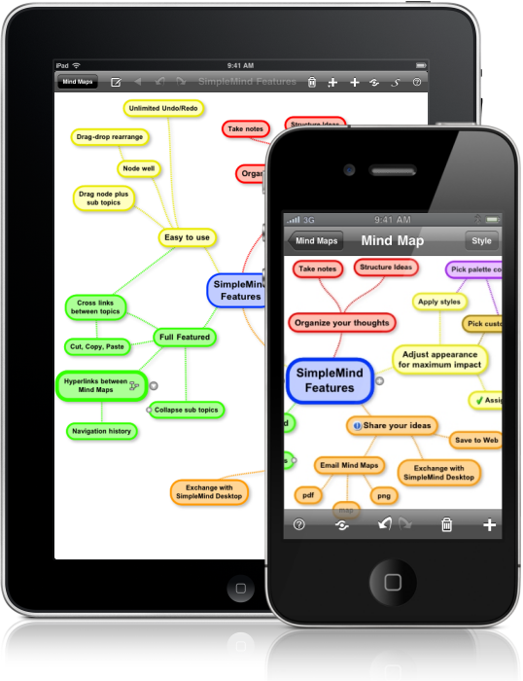
SimpleMind
SimpleMind is a Mind Mapping tool for idea and thought collection SimpleMind can help students’ comprehension across all subject areas. It is a simple tool to help students organize their thoughts on any topic. For example, if a student is studying geometric shapes in math they could organize their shapes in the web by number of sides. If a student is studying cells in science they could list all the parts of a cell with the proper definitions. If a student is studying grammar in ELA they could list all the parts of speech and examples in their web.

Slide 17
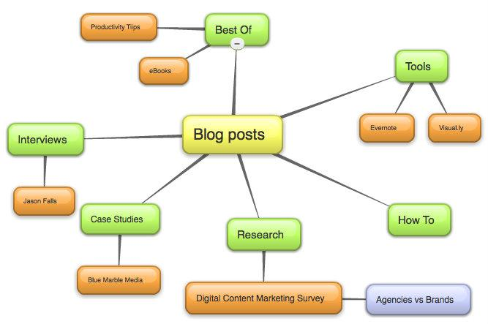
SimpleMind
Teacher
Student
SimpleMind is an application teachers can use with their students to help them organize their ideas and thoughts. SimpleMind creates webs where students type in keywords and it organizes their ideas in a web-like format. This application is great for students who have difficulty with reading comprehension because it allows them to list ideas about a topic as they read to help with understanding of the text.
Students can use SimpleMind as a brainstorming tool to organize their thoughts and ideas in a structured way. SimpleMind can be used for the iPhone / iPod Touch and iPad. These maps will allow the students to organize their understanding of a topic to help them study for tests, outline chapters, and brainstorm ideas for writing assignments.

Slide 18
Diigo
Teachers Can Use it To...
Create sticky notes that can be posted on articles and websites.
Highlight pre-determined text that students should focus on.
Bookmark websites for students to use on a project or activity.
Create classes that help facilitate group work.
Create "safe" classrooms that do not connect to the rest of Diigo.
Students Can Use it To...
Highlight text as they read through an article.
Take notes in the form of sticky notes throughout a text.
Answer questions about individual portions of texts.
Share resources with teachers and other group members.

Slide 19
Diigo and Reading Comprehension
Diigo allows teachers to highlight key features of text and ask questions about what students are reading.
  Students must "read into" text and are able to do so in manageable chunks. Questions are spaced throughout reading. Students that are overwhelmed with large selections of text will benefit from this.
Diigo allows teachers to structure readings and specifically focus on one particular reading comprehension strategy.
  Students can be asked to infer, compare and contrast, visualize, and synthesize throughout a text.
Diigo allows students to highlight key text.
  Students can visually see the text that they have highlighted and can take that information home. Students are able to easily disseminate important text.

Slide 20

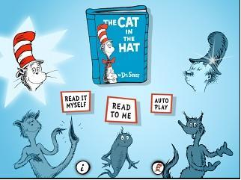
Oceanhouse Media Book Collection
-Popular Children's Titles
-Multiple Reading Options
-Professional Narration and Music
-Auditory assisted beginning readers with scaffolded assistance.

Slide 21


Twitter Hashtag
#appsthatwork

Slide 22


Resources
All resources used in this presentation can be accessed through our Diigo page

